Slide 1
GITA 2 Final Project
Galaga
Joshua Williams

Slide 2
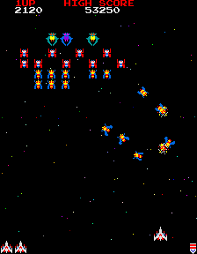
Objectives
This game is based on “Galaga” made by Namco in 1981. The goal of Galaga is to survive the attacks and kill the alien spaceships. This game is single player.

Slide 3
Controls
The user controls a spaceship that moves left with the left arrow key and right with the right arrow key.
The user shoots bullets by pressing the “S” key.

Slide 4
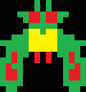


Characters
Alien 1
(50 points)
Alien 2
(80 points)
Alien 3
(400 points)

Slide 5
Overview
The user has three lives and the game has infinite levels: in the first two levels the aliens only move at the user, while in the following levels the aliens shoot at the user while moving at the user. An extra life can be earned by passing 20,000 points. Galaga is fun as the user attempts to survive and kill the aliens, which gets more difficult as the user progresses.

